Slide 1



Project
Tento
Latin word for “I try”
A free online evaluation platform for Cambridge students

Slide 2
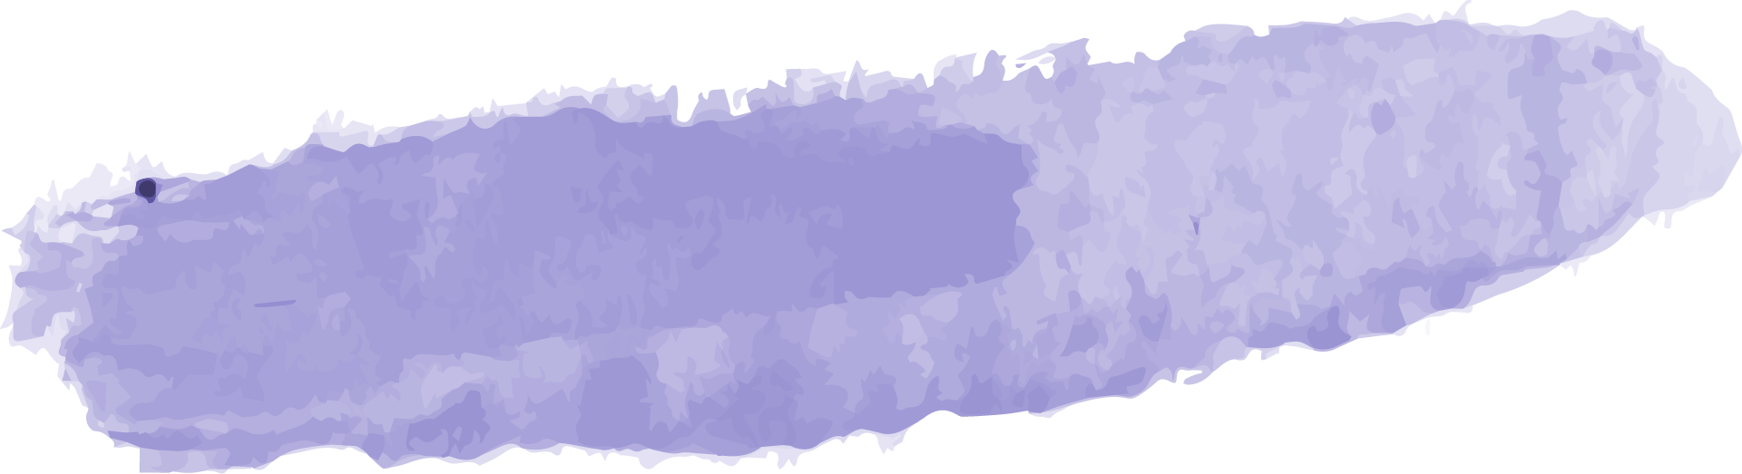


Our Team
Nafisa Maliyat
Kazi Jawadul Islam Jishan
Shanta Maria
200042133
200042165
200042172

Slide 3





Table of Contents
01
02
Motivation
03
Technology
Project
Overview
04
ERD
05
Features
06
Future
Work
07
Timeline
08
Demo

Slide 4
01
Project Overview

Slide 5
Online Educational Website
Free to use
Targeted audience: O and A level candidates
Evaluation using MCQs
Topics from the entire Cambridge syllabus
Vast range of subjects

Slide 6
02
Motivation

Slide 7

What Motivated Us?
Lack of online exam platforms for English Medium Students
Thousands of taka wasted on mock exams
Time wasted while going to different coaching centres

Slide 8
03
Technology

Slide 9



Technologies Used
Front End
Database
Back End
HTML, CSS, JavaScript
MySQL
PHP

Slide 10
04
Database ERD

Slide 11
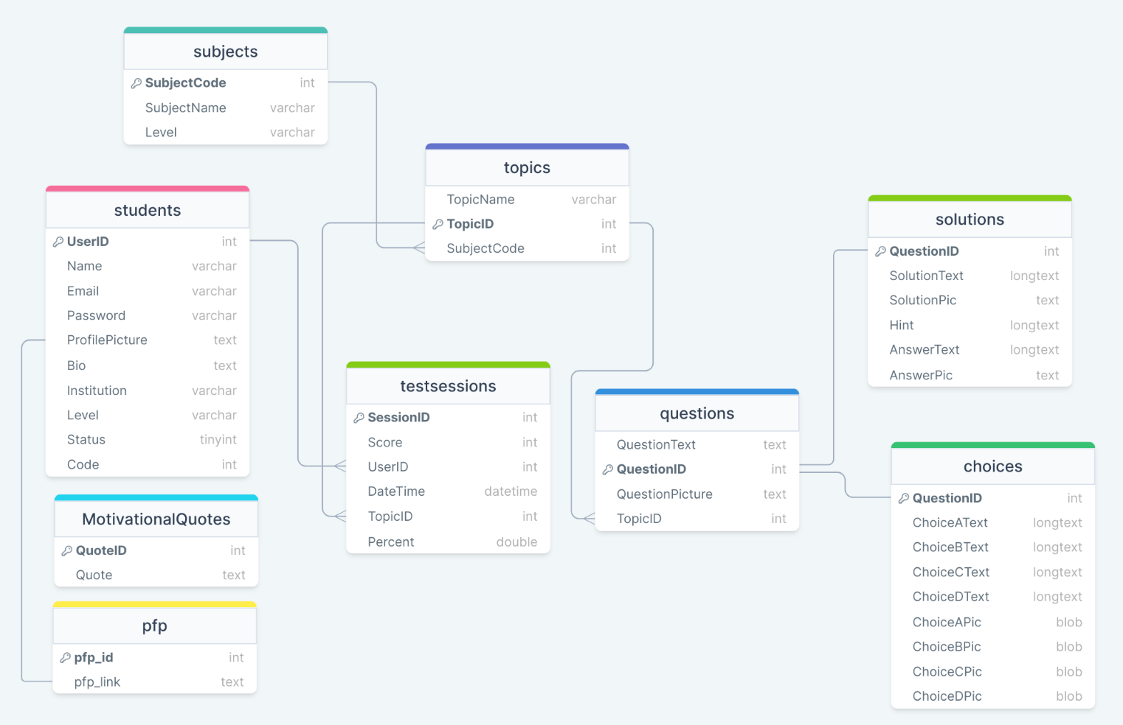
Database ERD

Slide 12
05
Features

Slide 13
Implemented Core
Features

Slide 14
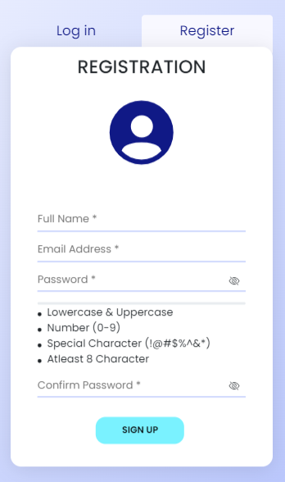
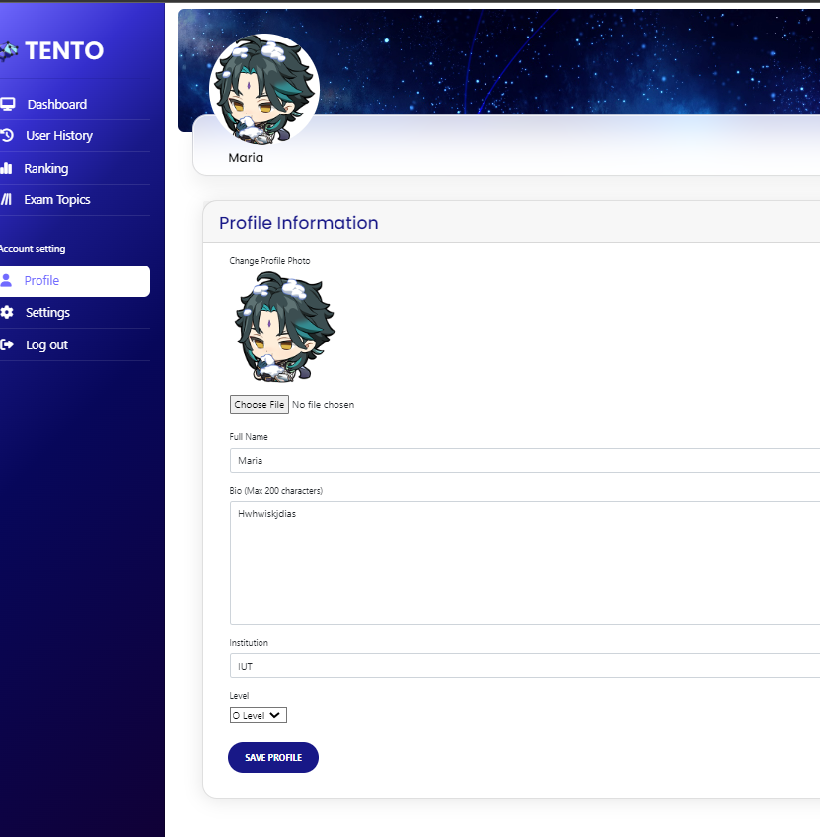
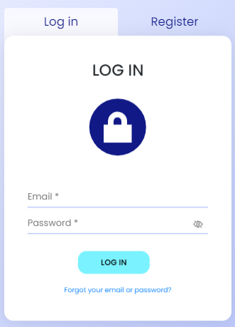
User Profile

Slide 15
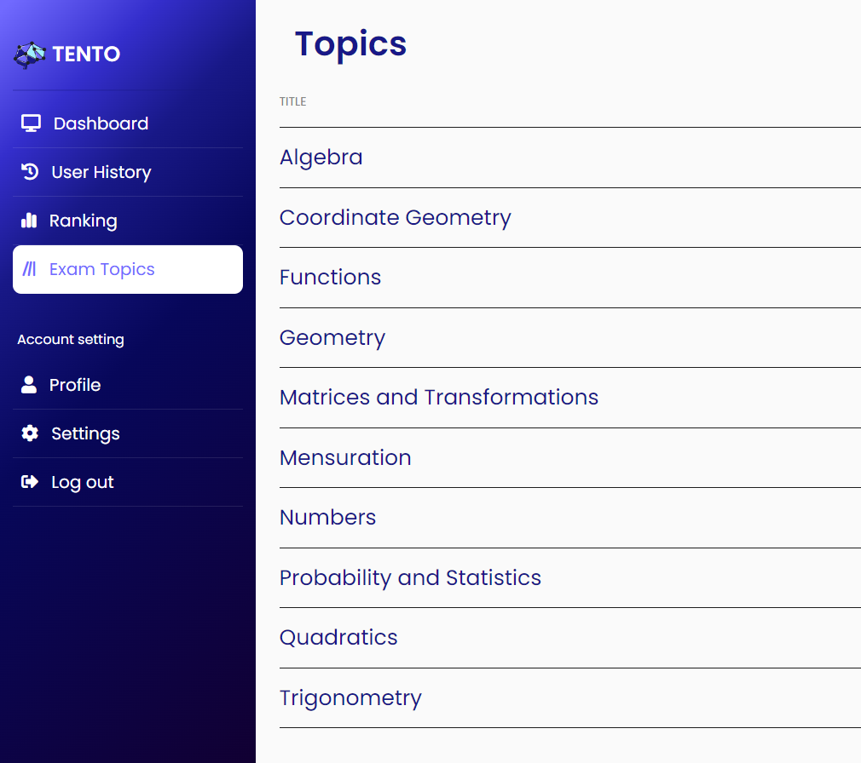
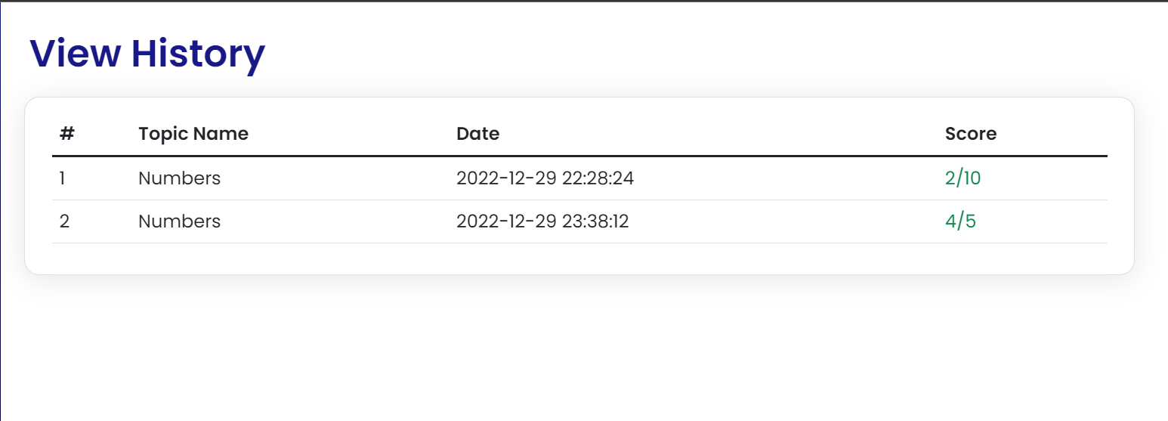
2. Selecting Topics
3. User History

Slide 16
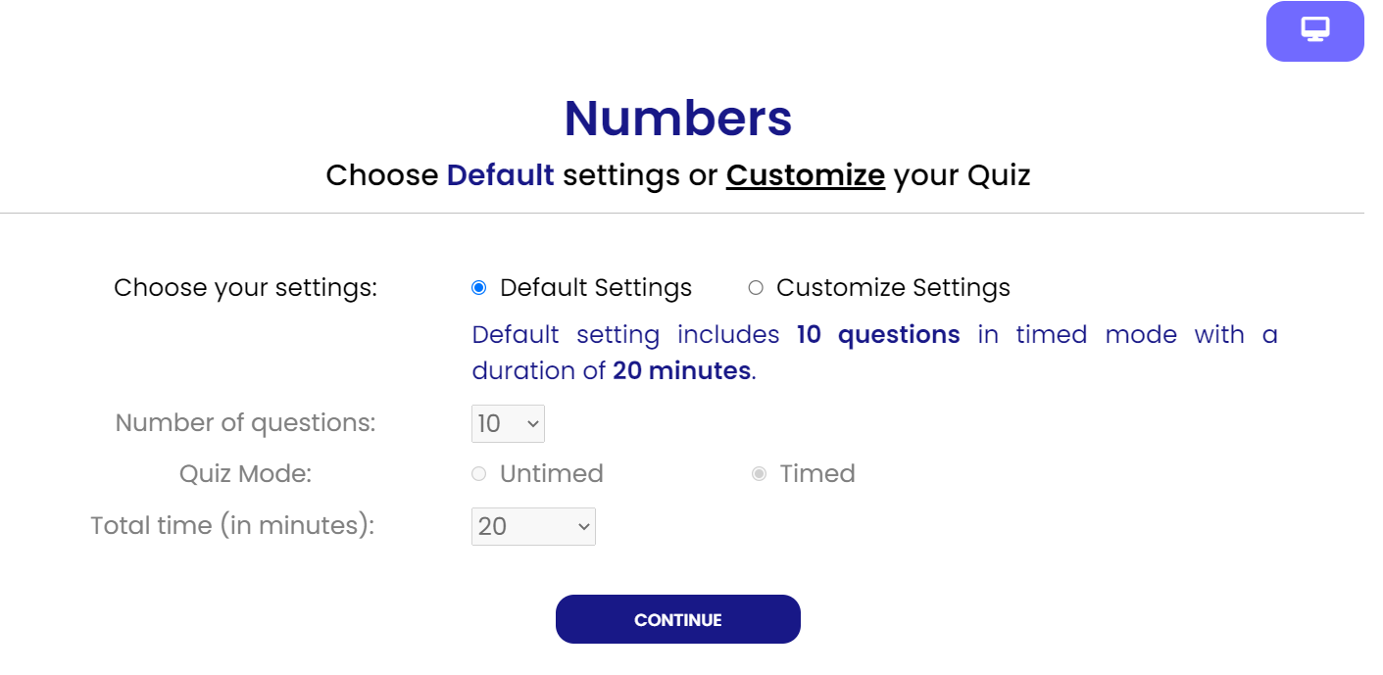
4. Timed/Untimed Mode

Slide 17
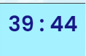
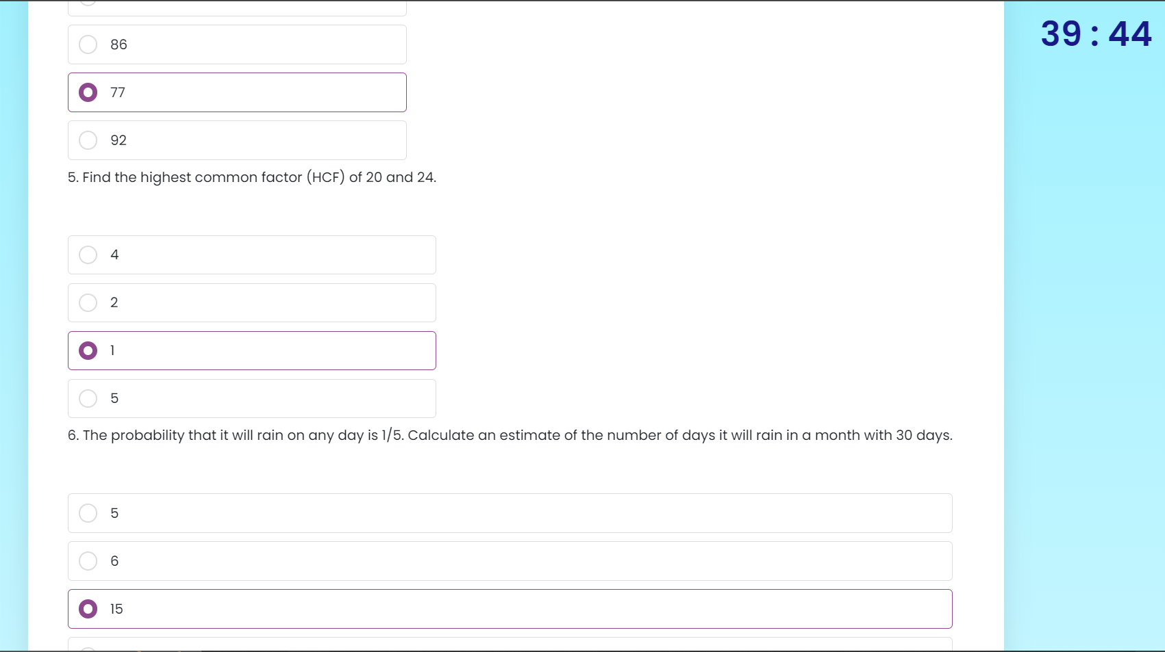
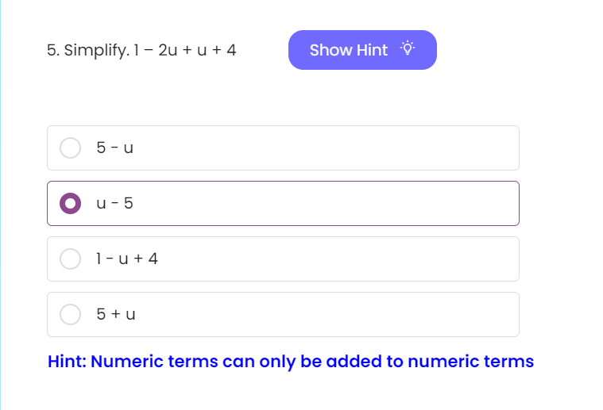
6. Timer
7. Hint Button
8. Answering MCQs

Slide 18
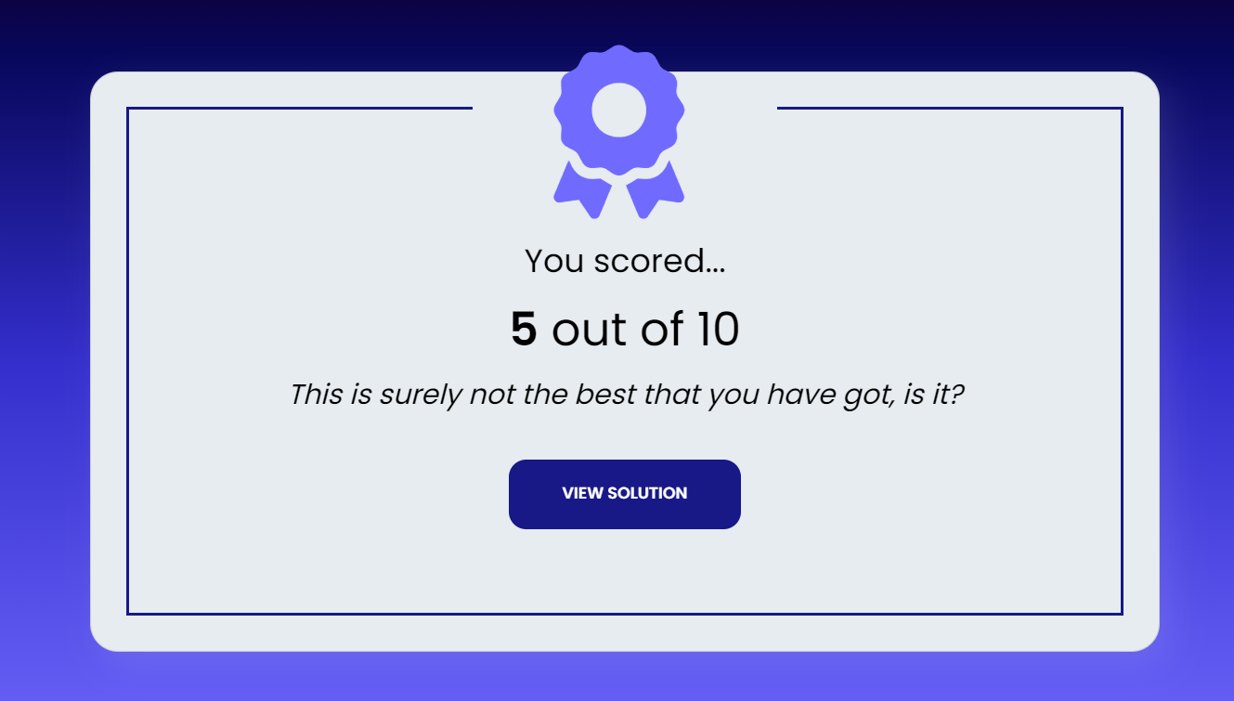
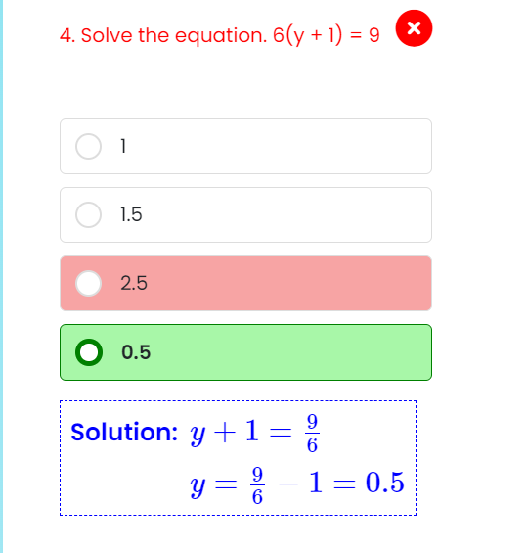
10. Detailed Solution
9. Viewing
Score

Slide 19
Dropped
Features

Slide 20
Next/Previous Buttons
Choosing Subjects

Slide 21
Implemented Suggested
Features

Slide 22
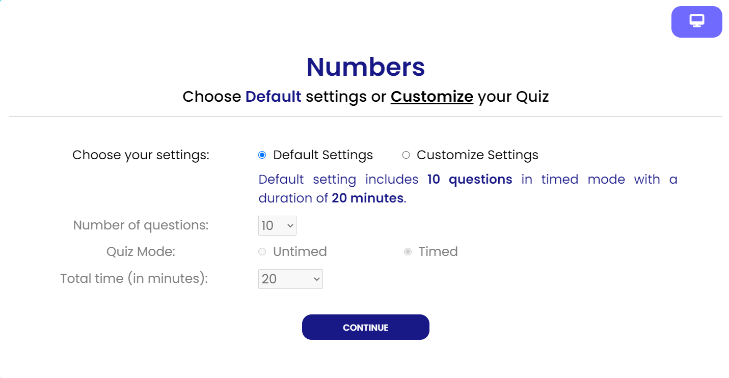
1. Dynamic Questions
2. Dynamic Time

Slide 23
06
Future Works

Slide 24
Dark Mode
User-user interaction
Admin Panel
Teachers as a user type

Slide 25
07
Timeline

Slide 26
Proposal Timeline

Slide 27
Week 1-2
Brainstorming
Idea
Week 3-4
Planning and Background Learning
Week 5-7
Front End Development
Week 8-10
Database Management
Week 11-12
Back End Development
Week 13
Buffer Time
Week 14
Testing

Slide 28
Progress Timeline

Slide 29
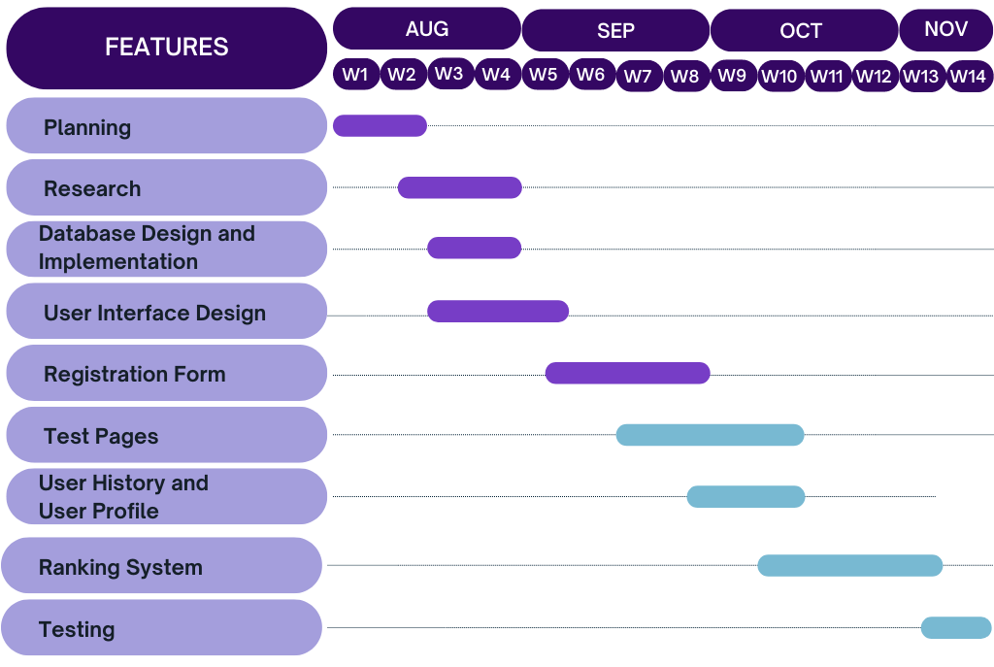
Where we were

Slide 30
Final Timeline

Slide 31
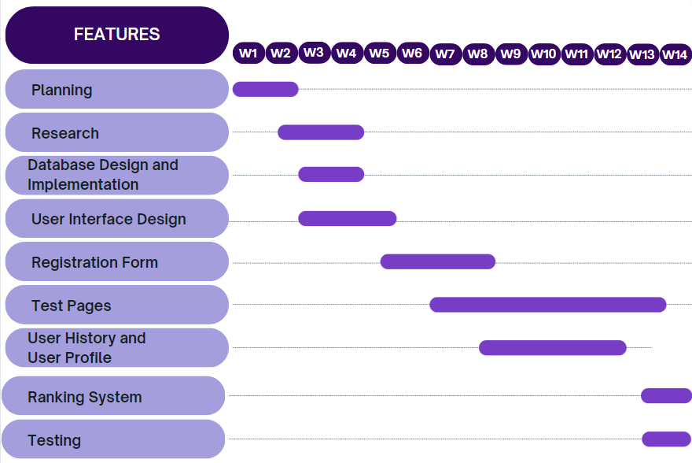
Where we are now

Slide 32
08
Demo

Slide 33
Thank you for listening. Any suggestions would be welcomed

